Slide 1
Capital Returns
An investor option

Slide 2
Opening the meeting
Proper notice was given to hold a meeting of the class A preference share holder of the Oxford Community Energy Co-op on March 16 2019
Graham Dyer, vice president will take meeting minutes
Agenda
Calling the meeting
Approval of the Agenda
Shareholder presentation – Capital Returns
Q&A
Selection of scrutineers
Ballot vote (including on-line voting)
Approval to destroy the ballots (after scrutineers completed their work)
Adjournment of the meeting

Slide 3
Communications
Text your first and last name to 519 788 2598
Then call the conference call number below
Phone number: 855-436-3635 - Access Code: 6350587#
Put you phone on mute
You can toggle between phone and text messaging
If you want to ask a question or comment text your name and ? Or ! (Miranda Fuller ? Or Helmut Schneider !)
I will call on you when we are ready for your question or comment
Un-mute your phone, state you name, ask the question / comment
Mute your phone

Slide 4
Summary
Share Redemption
Why - Benefits
Risk
Investors capital is returned early
Shares are bought back and extinguished
The outstanding share volume decreases by the same percentage for everyone
We will not allow the outstanding shares to go to zero before year 20 – the investor that now owns 1% of outstanding shares will own 1% in year 20
A more efficient capital strategy for the investors
You can re-invest your capital and achieve greater returns
We will still distribute all available funds in line with the financial strategy
Your return on investment increases
Full transparency – you will have a clear picture of the financial health
Potential tax benefits
No risk on investor returns – we still distribute the same $ value on lower $ investment
Managing investor expectations – you may expect capital returns every year which will not be possible
Administrative burden – OCEC must manage the admin record keeping well
Manage investor information – there will be more questions because the process is more complex

Slide 5
Timing
October 2018 Introduction of the concept at the AGM – it received positive feedback
January 2019 Developed the plan and sought advice from legal advisors
February 2019 Capital Returns draft paper was created
Presented the draft plan to legal advisors for comment
March 2019 Class A Shareholder Meeting - present plan to Shareholders for comment – receive a mandate from the shareholders on how to proceed – poll will close at noon tomorrow (Sunday March 17th)
May 2019 Prepare policy for OCEC board
July 2019 Communicate final policy to all class A shareholders
September 2019 Board to review available funds and timing of any 2019 Class A capital return amount
October 2019 Announce any capital returns to the class A shareholders (if any)
December 2019 Transfer funds to shareholders if capitals returns are made

Slide 6
Objective
a) Maintain a reasonable operational buffer for each operational business unit
b) Treat each investor group in a fair and equitable manner
c) Return equity funds earlier in the investment period, rather than only at the end of the project life

Slide 7
Financial Strategy
We suggest the following cashflow priorities for the next 5 years
Priority 1 – Fund the operating budget
Priority 2 - Regular bond interest payments for all bond holders
Priority 3 - Maintaining an adequate Operational Buffer
Priority 4 - Regular Dividends at 11% for Wind, 8% for Solar
Priority 5 – Redemption of shares to reduce outstanding equity

Slide 8
Current Status
Wind Bonds $ 705,000 5.5% 10 year (2027)
Solar Bonds $ 1,360,000 5% 10 year (2028)
Wind Equity $ 8,257,000 class A preference shares
Solar Equity $ 399,000 class B preference shares

Slide 9
Class A Preference Shares
Currently there have 8,257 issued and outstanding class A preference shares worth $1,000 each – combined value $ 8,257,000
We have about 110 class A preference shareholder owning different numbers of shares from as little as 5 shares to as much as 500 shares each
Any class A preference shares that are bought back by the OCEC will be retired immediately - the number of outstanding shares is thereby reduced by the number of bought back shares.
The number of outstanding stares can be found in the Shareholder Equity section of the balance sheet in the corporation’s financial statements.
Share redemption will be made as a percentage of your original ownership (avoids an increasing number of decimals in you share ownership)

Slide 10
Share Redemption Example
1 | Determine the available cash reserves now |  |  | $ 845,000
2 | Determine distribution from GHLP 2019 (estimated) |  | plus | $ 1,100,000
3 | Determine total available cash in 2019 |  |  | $ 1,945,000
4 | Determine the dividends for the year (projected) | 11% | minus | $ 980,270
5 | Determine the payment of bond interest | 5.5% | minus | $ 38,775
6 | Operational Buffer as determined by the board |  | minus | $ 500,000
7 | Remaining cash after buffer, interest and dividends |  |  | $ 425,955
8 | Determine the cost of a class A preference share buy-back
 | a) 1% $ 8,257,000 x 1% = $ 82,572
 | b) 2% $ 8,257,000 x 2% = $ 165,140
 | c) 3% $ 8,257,000 x 3% = $ 247,710
 | d) 4% $ 8,257,000 x 4% = $ 330,280 |  | minus | $ 330,280
 | e) 5% $ 8,257,000 x 5% = $ 412,850
9 | Remaining cash after buffer, interest, dividends and buy-back |  |  | $ 95,675

Slide 11
Impact on your investment - Example

Slide 12
Manage Expectations
The investors need to recognize that capital returns can only be made if the funds to do so are available and only if this action does not put the organization in financial risk. We do not anticipate that capital returns are made annually. The availability of reserves for capital returns is directly dependent on several factors:
There will be years when low wind resources will not allow us to redeem shares.
We anticipate in the future that, at times, OCEC will have to face corporate income tax burdens which may slow down the accumulation of reserves.
Investors need to recognize that the senior debt is structured in a way that provides the greatest returns in the last 3 years of the project life so the accumulation of reserves is not linear throughout the project life.
It is possible and likely that throughout the project life we may face repairs on the wind park that are not covered under the service agreement and require payment out of reserves

Slide 13
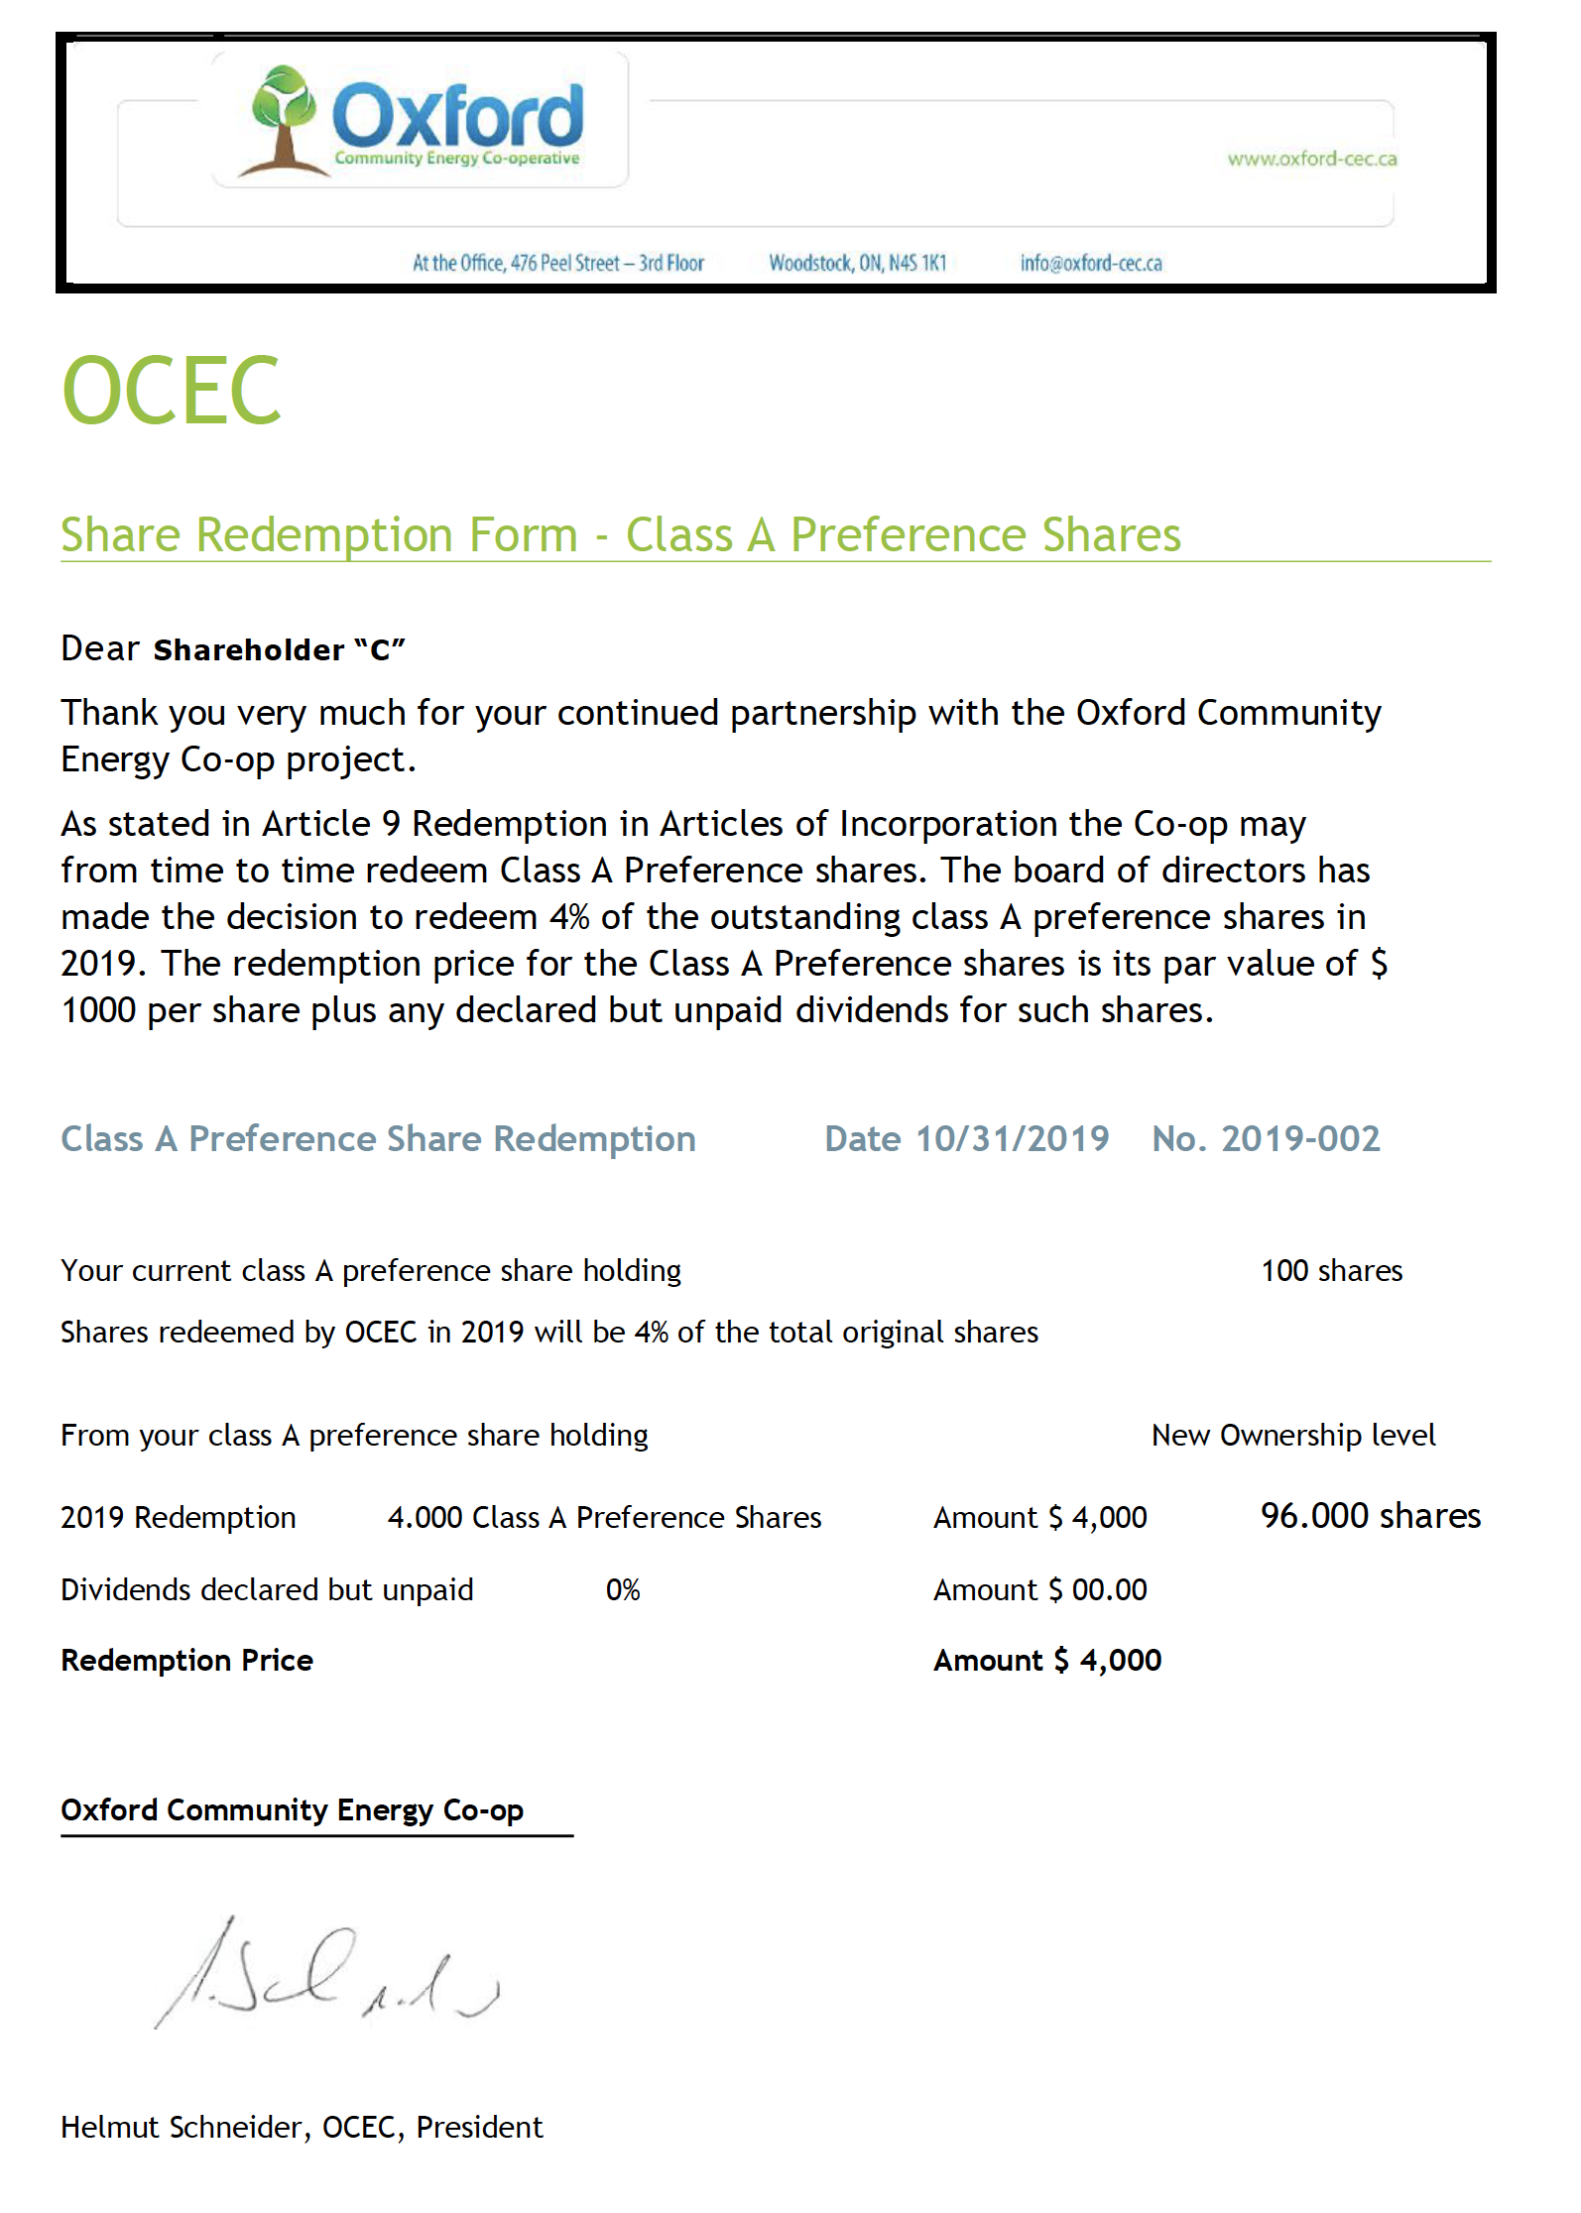
Statements
You will be provided with regular Statements
Share Ownership
Share Redemption
Dividend declaration
Share Certificates (periodically)

Slide 14
Q and A period
In person at the meeting
Indicate that you have a question or comment
State you name please and then the question/comment
I will repeat the question for the on-line community
I will try my best to answer the question
If you are On Line
Text me your first and last name and a ? or ! If you have a question (?) or a comment (!)
I will call on you by name
Take your phone off mute and state you question / comment – the audience will hear you through a speaker we set up
Put you phone on mute again please
Please be patient with us – this is the first time we are trying to have an on-line audience

Slide 15
Voting process
We suggest Dan Andres and Miranda Fuller to be scrutineers – need a motion and seconder and approval
Each share holder carries one vote for each share they own
We have a master list of your share ownership
We are using a ballot vote
Unless you clearly state that you only want to use a portion of your votes for your decision we assume you are placing all votes behind your decision (i.e. 50% or x votes)
For those that voted in the on line poll we have filled out their ballot already
The online poll will be open until noon tomorrow
If you are on the call you can either vote on line or text me your vote now

Slide 16
Closing
We need a motion to destroy the ballots after the vote has been tabulated on Monday
Adjourn the meeting
Thank you

